Slide 1


2
Introduction to SQL and SQL Commands
Vrushali Masane

Slide 2

THE BIG QUESTION
Databases hold billions of records.
How do humans/applications actually talk to them?
How does Instagram fetch your feed in milliseconds?
How does Amazon update prices for millions of users?
₹1,299
₹999
How can a bank undo a failed transaction?
How does a company decide who can access sensitive data?
A
B
2

Slide 3

BEFORE WE BEGIN
Quick recap — where we left off
What databases are, and why we store data in Databases ?
Why DBMS exists — to manage, secure, and organize that data ?
Why we prefer DBMS over File Based Storage Systems ?
THE NEXT QUESTION
"If the database stores data internally, how do users actually interact with it?"
3

Slide 4
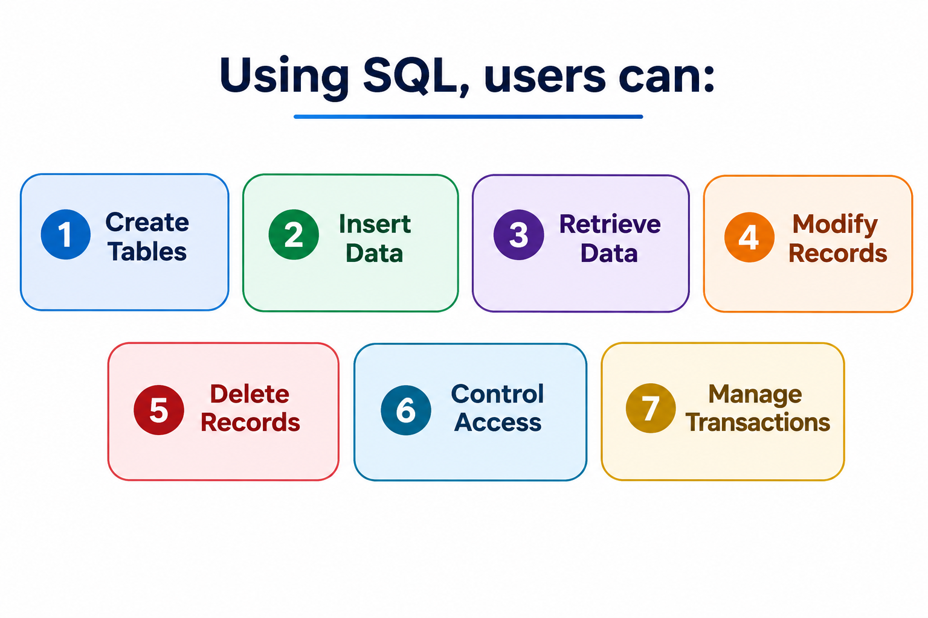

INTRODUCING SQL
SQL — the language of relational databases
SQL (Structured Query Language) is the standard language used to communicate with relational databases.
HOW THE CONVERSATION WORKS
SELECT name FROM "students"
User/
Application
rows returned
4

Slide 5
THE ANALOGY
A database is a library. SQL is the librarian’s language.
Organize
Arranging books on shelves → designing tables and schemas
Search
Finding a specific book fast → retrieving exact records
Modify
Replacing a damaged book → updating or deleting records
Secure
Reference-only sections → controlling who can access what
5

Slide 6






REAL-WORLD SYSTEMS
Popular Database Systems That Use SQL
MySQL
PostgreSQL
Widely used for web applications (e.g., WordPress)
Open-source database known for advanced features and SQL standards
Oracle
SQL Server
Enterprise database used by large organizations — banks, airlines, governments
Enterprise RDBMS integrated with the Microsoft ecosystem.
Although these databases have different features, they all use SQL as their standard language for managing and querying data.
6

Slide 7
One language, four job descriptions
As databases grew larger, SQL commands were grouped by the kind of task they perform — just like running a university.
DDL
DML
TCL
DCL
Data Definition Language Statements
Data Manipulation Language Statements
Transaction Control Language
Statements
Data Control Language
Statements
University analogy
University analogy
University analogy
University analogy
Constructing classrooms
Managing student records
Undoing mistakes safely
Deciding who gets access
8

Slide 8
DDL: Data Definition Language
DDL commands define and manage database structures — before any data can live inside a table, the table itself must exist.
These commands primarily affect:
Databases
Tables
Schema definitions
Four commands to know: CREATE · ALTER · TRUNCATE · DROP
10

Slide 9
DDL COMMAND 1
CREATE — building the classroom
THE PRINCIPAL WALKS IN
"We need somewhere to store every student’s ID and name before classes begin."
BEFORE
AFTER
No table yet
id
name
CREATE TABLE students (
id INT PRIMARY KEY,
name VARCHAR(50)
);
Schema design becomes executable
CREATE builds a brand-new database or table from a schema definition — the direct continuation of the table design from the previous lecture, now actually running.
11

Slide 10
IN PRACTICE — POSTGRESQL
CREATE DATABASE — the building before the classroom
CREATE TABLE needs a database to live in. In PostgreSQL, one server holds many databases — you create the database first, then connect to it.
Server (cluster)
→
Database
→
Schema
→
Table
CREATE DATABASE works at the second level — every schema and table you build later lives inside it.
-- the simplest form
CREATE DATABASE university;
-- with explicit options
CREATE DATABASE university
WITH OWNER = postgres
ENCODING = 'UTF8';
What PostgreSQL does
Creates a brand-new, isolated database inside the running server.
Copies the built-in template1 database as its starting point.
Does nothing to your session — you must connect to it next.
Must run outside a transaction block, and the name must be unique.
12

Slide 11
THE SAME COMMAND, THREE DOORWAYS
Three ways to create a database in PostgreSQL
1
psql (SQL)
2
createdb (terminal)
3
pgAdmin (GUI)
Type SQL straight into any Postgres client.
A command-line wrapper shipped with Postgres.
Point-and-click, no typing required.
CREATE DATABASE
university;
createdb -U postgres
university
Databases → right-click
→ Create → Database…
The canonical way — works in psql, pgAdmin’s query tool, or any driver.
One line in the shell — handy in scripts and setup automation.
Fill in name and owner, hit Save — pgAdmin writes the SQL for you.
All three end at the same place: a new, empty database registered in the server. Only the doorway differs.
13

Slide 12
END TO END
From database to table — one psql session
$ psql -U postgres
postgres=# CREATE DATABASE university;
CREATE DATABASE
postgres=# \c university
You are now connected to "university".
university=# CREATE TABLE students (
university-# id INT PRIMARY KEY,
university-# name VARCHAR(50)
university-# );
CREATE TABLE
university=# \dt
public | students | table | postgres
Meta-commands to remember
\l
list every database
\c name
connect to one
\dt
list tables here
\d students
describe a table
\q
quit psql
Handle with care
DROP DATABASE university; removes the database and every table, row and schema inside it — permanently, with no WHERE and no undo.
14

Slide 13
DDL COMMAND 2
ALTER — renovating the classroom
THE PRINCIPAL WALKS IN
"We also need to track each student’s branch. Add that column without losing any existing data."
BEFORE
AFTER
id
name
id
name
branch
ALTER TABLE students
ADD COLUMN branch VARCHAR(20);
1
Amit
1
Amit
CSE
branch column added
One command, many targets
ALTER modifies an existing structure — add, rename, or drop columns, change data types, or adjust constraints like PRIMARY KEY, all without rebuilding the table.
12

Slide 14
DDL COMMAND 2 · IN DEPTH
Everything ALTER can change about a table
One statement, many jobs. ALTER never touches the rows you already have — it reshapes the structure around them.
ADD COLUMN
DROP COLUMN
RENAME COLUMN
Add a new field to an existing table.
Remove a field and all data in it.
Give an existing field a new name.
ALTER TABLE students
ADD COLUMN branch VARCHAR(20);
ALTER TABLE students
DROP COLUMN branch;
ALTER TABLE students
RENAME COLUMN name TO full_name;
ALTER COLUMN TYPE
SET / DROP DEFAULT
ADD CONSTRAINT
Change a field’s data type or size.
Control the value used when none is given.
Enforce a rule: PRIMARY KEY, UNIQUE, CHECK.
ALTER TABLE students
ALTER COLUMN name TYPE VARCHAR(100);
ALTER TABLE students
ALTER COLUMN branch SET DEFAULT 'CSE';
ALTER TABLE students
ADD CONSTRAINT uq_email UNIQUE (email);
Also available: RENAME TO (rename the whole table), DROP CONSTRAINT, SET NOT NULL / DROP NOT NULL, and OWNER TO.
17

Slide 15
ALTER IN ACTION
Four renovations, one students table
-- 1. add a column
ALTER TABLE students
ADD COLUMN email VARCHAR(60);
-- 2. widen an existing column
ALTER TABLE students
ALTER COLUMN name TYPE VARCHAR(100);
-- 3. enforce a rule
ALTER TABLE students
ADD CONSTRAINT uq_email UNIQUE (email);
-- 4. remove what is no longer needed
ALTER TABLE students
DROP COLUMN email;
STRUCTURE BEFORE
id
INT
name
VARCHAR(50)
STRUCTURE AFTER STEPS 1–3
id
INT
name
VARCHAR(100)
widened
email
VARCHAR(60) UNIQUE
new
Existing rows survive every one of these — except DROP COLUMN, which deletes that column’s data for every row. Adding a NOT NULL column to a table that already has rows needs a DEFAULT, or PostgreSQL refuses.
18

Slide 16
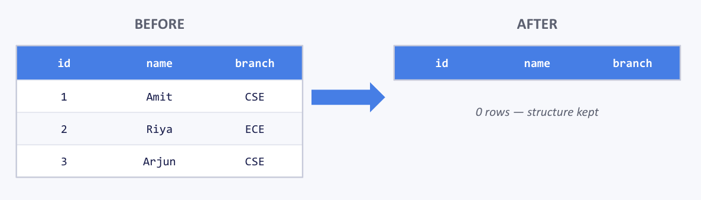
DDL COMMAND 3
TRUNCATE — emptying the bucket
THE PRINCIPAL WALKS IN
"New semester — clear out last year’s student roster, but keep the students table ready for the new batch."
BEFORE
AFTER
id
name
branch
id
name
branch
TRUNCATE TABLE students;
1
Amit
CSE
0 rows — structure kept
2
Riya
ECE
3
Arjun
CSE
Analogy: emptying a bucket
TRUNCATE removes all records instantly while keeping the table structure fully intact — like emptying a bucket without losing the bucket itself. No filtering; it’s all rows, every time.
13

Slide 17
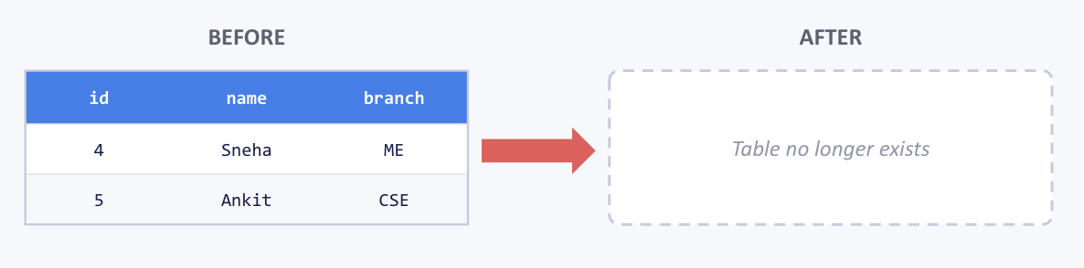
DDL COMMAND 4
DROP — throwing away the bucket
THE PRINCIPAL WALKS IN
"This batch’s program has ended. Remove the students table completely — structure and all."
BEFORE
AFTER
id
name
branch
Table no longer exists
DROP TABLE students;
4
Sneha
ME
5
Ankit
CSE
Analogy: throwing away the bucket
DROP completely removes a database object — table, structure, and every row inside it — permanently. Unlike TRUNCATE, there is nothing left to reuse afterward.
14

Slide 18
Checkpoint — DDL
1. Which command removes only the records inside a table?
2. Which command removes the complete table itself?
3. Why might ALTER become important as an application evolves?
15

Slide 19
Checkpoint — DDL
1. Which command removes only the records inside a table?
A: TRUNCATE — removes all rows instantly but keeps the table structure intact for reuse.
2. Which command removes the complete table itself?
A: DROP — deletes the table's structure and data permanently; nothing is left to reuse.
3. Why might ALTER become important as an application evolves?
A: Requirements change over time — ALTER lets you add, modify, or drop columns and constraints without losing existing data or rebuilding the table.
15

Slide 20
PART 4 — DML
DML: Data Manipulation Language
If DDL builds the structure, DML handles the contents — it’s how we work with the data actually living inside tables.
Four commands to know:
INSERT — add new rows
SELECT — retrieve rows
UPDATE — modify existing rows
DELETE — remove selected rows
16

Slide 21
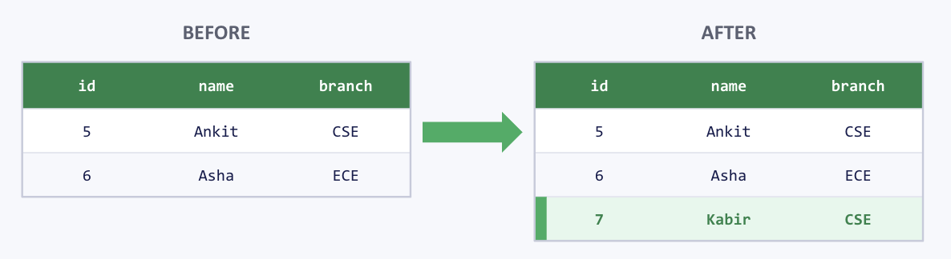
DML COMMAND 1
INSERT — enrolling a new student
THE PRINCIPAL WALKS IN
"A new student just joined CSE. Add their record to the roll."
BEFORE
AFTER
INSERT INTO students
(id, name, branch)
VALUES
(7, 'Kabir', 'CSE');
id
name
branch
id
name
branch
5
Ankit
CSE
5
Ankit
CSE
6
Asha
ECE
6
Asha
ECE
7
Kabir
CSE
Adding rows, one at a time (or many)
INSERT adds new rows of data into a table. You can insert a single row, or list several VALUES groups to add many rows in one statement.
17

Slide 22
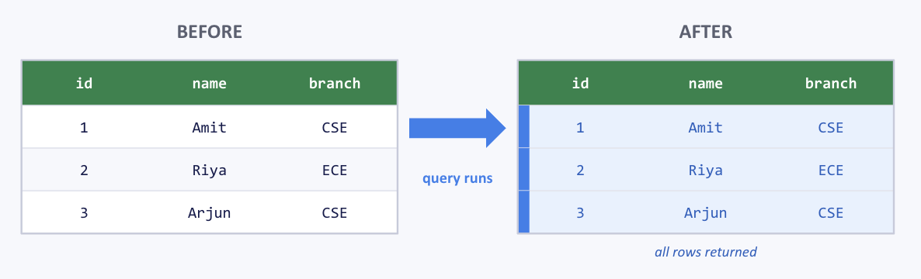
DML COMMAND 2
SELECT — asking the database a question
THE PRINCIPAL WALKS IN
"Just show me the whole list — every student you have."
BEFORE
AFTER
id
name
branch
id
name
branch
SELECT *
FROM students;
1
Amit
CSE
1
Amit
CSE
2
Riya
ECE
query runs
2
Riya
ECE
3
Arjun
CSE
3
Arjun
CSE
all rows returned
The most-used command in the industry
SELECT retrieves data — it changes nothing. It’s the command you’ll write more than any other. We’ll go deep on filtering, sorting, and pagination with SELECT in the very next lecture.
18

Slide 23
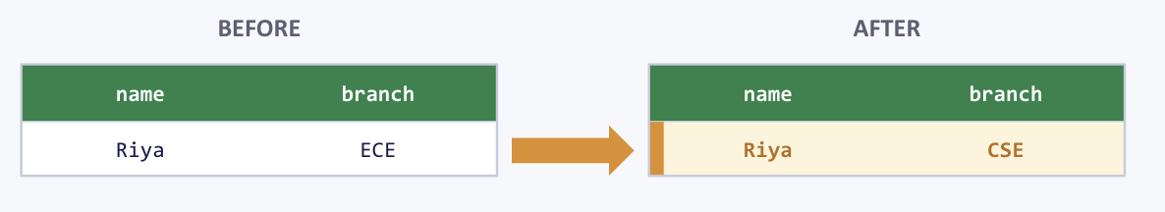
DML COMMAND 3
UPDATE — correcting a mistake
THE PRINCIPAL WALKS IN
"Riya’s branch was entered wrong — she’s actually in CSE, not ECE."
BEFORE
AFTER
name
branch
name
branch
UPDATE students
SET branch = 'CSE'
WHERE name = 'Riya';
Riya
ECE
Riya
CSE
Always pair UPDATE with WHERE
UPDATE modifies existing data in place. Without a WHERE clause, it updates every single row in the table — a classic and costly mistake.
19

Slide 24
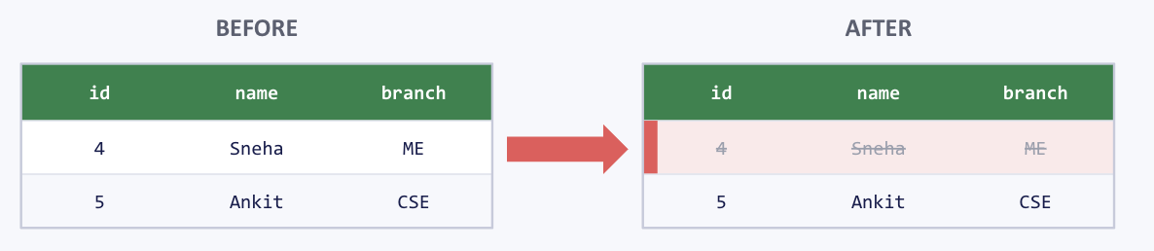
DML COMMAND 4
DELETE — removing a student record
THE PRINCIPAL WALKS IN
"This student dropped out last month. Remove their record."
BEFORE
AFTER
id
name
branch
id
name
branch
DELETE FROM students
WHERE name = 'Sneha';
4
Sneha
ME
4
Sneha
ME
5
Ankit
CSE
5
Ankit
CSE
Removes selected rows, with conditions
DELETE removes rows that match a WHERE condition — one row, several, or (with no condition at all) every row — while the table structure stays exactly as it was.
20

Slide 25
IMPORTANT COMPARISON
DELETE vs TRUNCATE vs DROP
DELETE
TRUNCATE
DROP
Removes selected rows
Can use a WHERE condition
Slower (row-by-row)
Table structure stays
Category: DML
Removes ALL rows
No filtering condition
Faster (bulk operation)
Table structure stays
Category: DDL
Removes the table itself
No filtering condition
Fastest — structure gone too
Table structure is deleted
Category: DDL
Why is TRUNCATE faster than DELETE? DELETE logs each row removal individually; TRUNCATE deallocates the data pages in bulk.
21

Slide 26
Checkpoint — DML
1. Why is the WHERE clause so important in UPDATE and DELETE?
2. Can DELETE remove only one row?
3. Which single command only retrieves data without changing it?
15

Slide 27
Checkpoint — DML
1. Why is the WHERE clause so important in UPDATE and DELETE?
A: Without WHERE, the command applies to every row in the table — WHERE scopes the change to only the intended row(s).
2. Can DELETE remove only one row?
A: Yes — pair DELETE with a WHERE condition that uniquely identifies that row, e.g. WHERE id = 5.
3. Which single command only retrieves data without changing it?
A: SELECT — it reads and returns rows but never modifies the underlying data.
15

Slide 28
TCL: what if the system crashes mid-way?
SCENARIO: Online Banking Transfer
ACCOUNT A · Step 1
ACCOUNT B · Step 3
!
₹10,000
₹8,000
SYSTEM CRASHES
₹5,000 (–5,000)
right at this exact moment
₹8,000 (+0,000)
Money vanished from Account A, never reached Account B — unless the database can guarantee "all steps, or none."
23

Slide 29


TCL COMMAND 1
COMMIT — locking in the changes
THE PRINCIPAL WALKS IN
“Both steps of the transfer succeeded — save it for good.”
BEGIN;
UPDATE accounts SET balance
= balance - 5000
WHERE id='A';
UPDATE accounts SET balance
= balance + 5000
WHERE id='B';
COMMIT;
What COMMIT does
• Makes every change since BEGIN permanent
• Visible to every other session once it runs
• Until then, only this session sees it
• Can't be undone with ROLLBACK afterward
See the account balances move through each stage on the next slide →
24

Slide 30
TCL COMMAND 1 · RESULT
COMMIT: tracing the account balances
BEFORE TRANSACTION
PENDING
AFTER COMMIT
acct | balance
A | 10,000
B | 8,000
acct | balance
A | 5,000
B | 13,000
acct | balance
A | 5,000
B | 13,000
UPDATES
run
COMMIT
nothing has run yet
uncommitted — this session only
✓ permanent, visible to all
Same numbers as the query: A drops by 5000, B rises by 5000. COMMIT only changes visibility — the values were already set in the pending stage.
25

Slide 31
TCL COMMAND 2
ROLLBACK — undoing a mistake
THE PRINCIPAL WALKS IN
“Wait — Account A has insufficient balance! Undo everything since the transaction started.”
-- Step 1: Deduct ₹2000 from Account A
UPDATE accounts
SET balance = balance - 2000
WHERE id = 'A';
-- Step 2: Check the balance
SELECT balance FROM accounts
WHERE id = 'A';
-- Suppose the query returns: -1000
-- This means Account A has insufficient balance.
ROLLBACK;
What ROLLBACK does
• Reverses changes since BEGIN / last COMMIT
• Only works before COMMIT runs
• Safety net for mid-transaction mistakes
• After it runs, nothing happened at all
See Account A's balance snap back to its original on the next slide →
26

Slide 32

TCL COMMAND 2 · RESULT
ROLLBACK: tracing Account A's balance
BEFORE TRANSACTION
PENDING (checked)
AFTER ROLLBACK
Account A
Account A
Account A
₹ 1,000
₹ − 1,000
₹ 1,000
UPDATE
runs
ROLLBACK;
a healthy starting balance
SELECT reveals: insufficient!
✓ original balance restored
The SELECT check caught it in time: the UPDATE alone would leave Account A at ₹−1,000 — invalid. Since it's still uncommitted, ROLLBACK undoes it instantly, before that bad value could ever be saved.
27

Slide 33
TCL COMMAND 3
SAVEPOINT — a checkpoint you return to
THE PRINCIPAL WALKS IN “This transfer has two steps — undo only the second one, not the whole transaction.”
BEGIN;
UPDATE accounts SET balance
= balance - 5000 WHERE id='A';
SAVEPOINT sp1;
UPDATE accounts SET balance
= balance + 5000 WHERE id='B';
SAVEPOINT sp2;
-- step 2 was wrong, keep step 1
ROLLBACK TO sp1;
What SAVEPOINT does
• Marks a checkpoint inside a transaction
• ROLLBACK TO undoes only steps after it
• Steps before that checkpoint stay intact
• Undo part of a transaction, not all of it
See the balances move through each checkpoint on the next slide →
28

Slide 34
TCL COMMAND 3 · RESULT
SAVEPOINT: tracing each checkpoint
START
A: 10,000 B: 8,000
transaction begins
AFTER STEP 1 → SAVEPOINT sp1
A: 5,000 B: 8,000
checkpoint sp1 marks this state
AFTER STEP 2 → SAVEPOINT sp2
A: 5,000 B: 13,000
checkpoint sp2 marks this state
ROLLBACK TO sp1
A: 5,000 B: 8,000
✓ only step 2 undone — step 1 kept
The point of SAVEPOINT: ROLLBACK TO sp1 undoes only the credit to B — the debit from A (before sp1) stays exactly as it was.
29

Slide 35
Checkpoint — TCL
1. Why are transactions critical in financial systems?
2. What happens to the changes if COMMIT is never executed?
3. Why might SAVEPOINT be useful in a long, multi-step workflow?
15

Slide 36
Checkpoint — TCL
1. Why are transactions critical in financial systems?
A: They guarantee a multi-step operation, like a funds transfer, either completes fully or not at all — preventing money from vanishing if the system crashes mid-way.
2. What happens to the changes if COMMIT is never executed?
A: The changes stay pending and uncommitted — they aren't permanently saved, and can still be rolled back or lost if the session ends.
3. Why might SAVEPOINT be useful in a long, multi-step workflow?
A: It lets you roll back to a specific checkpoint instead of undoing the entire transaction — like a save point in a video game.
15

Slide 37
DCL: Data Control Language
DCL commands control permissions and access within a database — deciding exactly who is allowed to do what.
Real-world significance:
Faculty should access student records
Interns should not delete student records
Admins get full privileges
28

Slide 38
GRANT — handing out the keys
THE PRINCIPAL WALKS IN
"Give the faculty team read access to the students table — nothing more."
BEFORE
AFTER
faculty_team → students (SELECT)
✕ BLOCKED
GRANT SELECT ON students
TO faculty_team;
GRANT SELECT
faculty_team → students (SELECT)
✓ALLOWED
Provides permissions
GRANT gives a user or role specific privileges — SELECT, INSERT, UPDATE, DELETE, or even administrative rights — on a database object.
29

Slide 39
DCL COMMAND 2
REVOKE — taking back access
THE PRINCIPAL WALKS IN
"The intern’s project is over — remove their permission to delete records."
BEFORE
AFTER
intern_role → students (DELETE)
✓ ALLOWED
REVOKE DELETE ON students
FROM intern_role;
REVOKE DELETE
intern_role → students (DELETE)
✕ BLOCKED
Removes permissions
REVOKE withdraws privileges previously granted. Together, GRANT and REVOKE let administrators keep access tightly matched to what each role actually needs.
30

Slide 40
Checkpoint — DCL
1. Should every employee get DELETE permission by default?
2. Why are access restrictions important in enterprise systems?
3. What risks can occur without permission control?
15

Slide 41
Checkpoint — DCL
1. Should every employee get DELETE permission by default?
A: No — follow the principle of least privilege; grant DELETE only to roles that genuinely need it.
2. Why are access restrictions important in enterprise systems?
A: They protect sensitive data from unauthorized access or accidental/malicious changes, and keep accountability clear across roles.
3. What risks can occur without permission control?
A: Unauthorized data access, accidental or malicious deletion/modification, compliance violations, and no clear accountability for who changed what.
15

Slide 42
RECAP
Your SQL command toolkit
DDL
CREATE · ALTER · TRUNCATE · DROP
DML
INSERT · SELECT · UPDATE · DELETE
TCL
COMMIT · ROLLBACK · SAVEPOINT
DCL
GRANT · REVOKE
Remember the trios
DELETE vs TRUNCATE vs DROP · COMMIT vs ROLLBACK · GRANT vs REVOKE · CREATE vs ALTER
33

Slide 43
BACK TO WHERE WE STARTED
"How do humans actually communicate with databases?"
SQL is not just a query language — it is the operational backbone of relational database systems.
structures are created
data is manipulated
transactions are protected
access is controlled
Without SQL, databases would simply be storage systems with no meaningful way to interact with them.
34

Slide 44

21

Slide 45

Please fill the
feedback form.
34

Slide 46

Thanks
for
watching!

